Slide 1


CODAR: Center for Online Data Analysis and Reduction, an ECP Codesign Center
Ian Foster, Argonne November 16, 2016 SC’16
Applications
CODAR
Data services
Exascale platforms

Slide 2
The CODAR team
PI: Ian Fosterª
Co-Is: Scott Klaskyº, Kerstin Kleese-Van Dam^{b}, Todd Munsonª
Participants: Mark Ainsworth^{d}, Franck Cappelloª, Barbara Chapman^{b,s}, Jong Choiº, Emil Constantinescuª, Hanqi Guoª, Tahsin Kurc^{s}, Qing Liuº, Jeremy Logan, Klaus Mueller^{s}, George Ostrouchovº, Manish Parashar^{r}, Tom Peterkaª, Norbert Podhorszkiº, Dave Pugmireº, Rangan Sukumarº, Stefan Wildª, Matthew Wolfº, Justin Wozniakª, Wei Xu^{b}, Shinjae Yoo^{b}
a: Argonne National Laboratory b: Brookhaven National Laboratory o: Oak Ridge National Laboratory
d: Brown University r: Rutgers University s: Stony Brook University
Notes:
We need photos for everyone

Slide 3
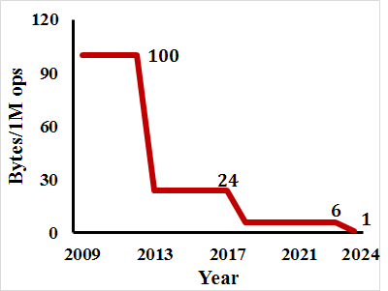
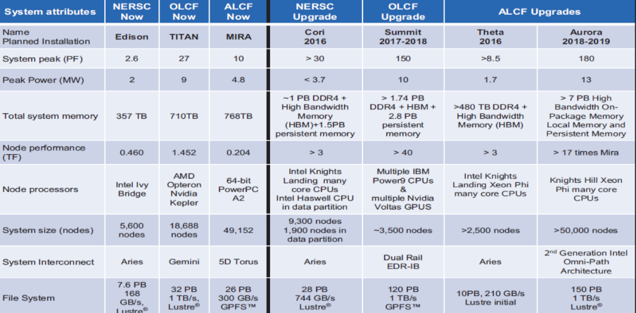
The compute-data gap is a major challenge for exascale
Filesystem/network bandwidth falls behind CPU/memory: Fewer bytes/operation
Swap I/O for CPU cycles:
Data (de)compression
Online data analysis
Right bytes in right place at right time!
Applications are already demanding 100 PBs of data for ‘medium-term’ (12 months)

Slide 4
The need for online data analysis and reduction
Traditional approach: Simulate, output, analyze
New approach: Online data analysis and reduction
Write simulation output to secondary storage; read back for analysis
Decimate in time when simulation output rate exceeds output rate of computer
Co-optimize simulation, analysis, reduction for performance and information output
Substitute CPU cycles for I/O, via data (de)compression and/or online data analysis
Right bytes in right place at right time
Notes:
Add pictures

Slide 5
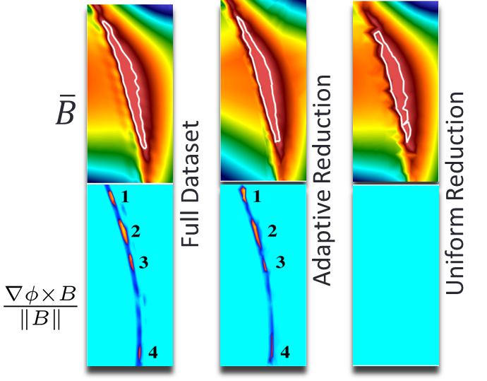
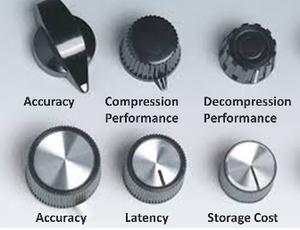
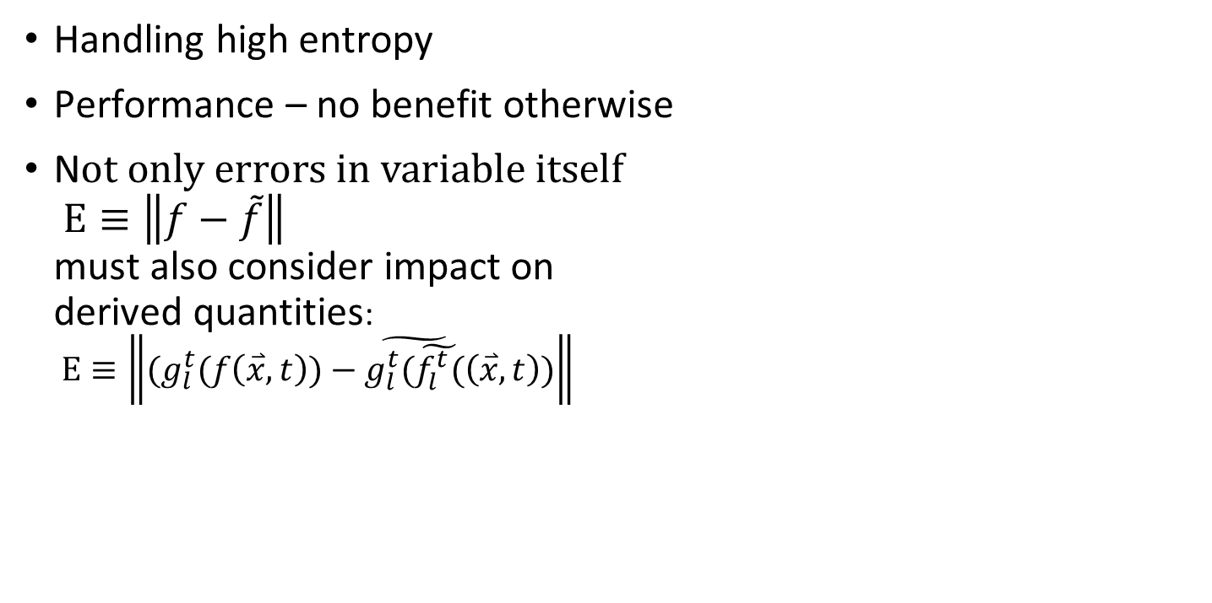
Reduction comes with challenges
Handling high entropy
Performance – no benefit otherwise
N$ot only errors in variable itself$ $Ε≡\left\|f−\tilde{f}\right\|$ must also consider impact on derived quantities: $Ε≡\left\|(g_{l}^{t}(f\left(\overset{⃑}{x},t\right))−\tilde{g_{l}^{t}(\tilde{f_{l}^{t}(}}\left(\overset{⃑}{x},t\right))\right\|$
Where did it go?
400 X reduction techniques

Slide 6
Data reduction is a multi-faceted challenge
Science understanding requires massive data reduction
How do we reduce
The time spent in reducing the data to information?
The amount of data being moved on the exascale platform?
The amount of data being read from the storage system?
The amount of data stored in memory, on the storage system, being moved over WAN?
Without removing the information
Requires deep dives into application post processing routines and simulations

Slide 7
The co-design concept and exascale computing
Exascale co-design:
Evaluate, deploy, and integrate exascale hardware-savvy software designs and technologies for key crosscutting algorithmic motifs into applications

Slide 8
CODAR codesign questions
What are the best data analysis and reduction algorithms for different application classes, in terms of speed, accuracy, and resource requirements? How can we implement those algorithms to achieve scalability and performance portability?
What are the tradeoffs in data analysis accuracy, resource needs, and overall application performance between using various data reduction methods to reduce file size prior to offline data reconstruction and analysis vs. performing more online data analysis? How do these tradeoffs vary with exascale hardware and software choices?
How do we effectively orchestrate online data analysis and reduction to reduce associated overheads? How can exascale hardware and software help with orchestration?

Slide 9
CODAR work areas
Infrastructure development and deployment
Enable rapid composition of application and “data services” (data reduction methods, data analysis methods, etc.)
Support CODAR-developed, ECP-developed, and other data services
Method development: new reduction & analysis routines
Motif-specific: e.g., finite difference mesh vs. particles vs. finite elements
Application-specific: e.g., reduced physics to understand deltas
Application engagement
Understand data analysis and reduction requirements
Integrate, deploy, evaluate impact
Notes:
Challenges in data reduction
Understanding the science requires massive data reduction
How do we reduce
The time spent in reducing the data to knowledge?
The amount of data being moved on the exascale platform?
The amount of data being read from the storage system?
The amount of data stored in memory, on the storage system, being moved over WAN?
Without removing the knowledge.
Requires deep dives into the application post processing routines and simulations

Slide 10
Prototypical CODAR data analysis and reduction pipeline
Running simulation
CODAR data API
I/O system
CODAR runtime
CODAR data analysis
CODAR data reduction
CODAR data monitoring
Multivariate statistics
Application-aware
Error calculation
Offline data analysis
CODAR data API
Feature analysis
Transforms
Refinement hints
Outlier detection
Encodings
Reduced output and reconstruction info
Simulation knowledge: application, models, numerics, performance optimization, …

Slide 11
CODAR building blocks
Runtime building blocks
ADIOS
Swift
Dataspaces
Decaf
Data reduction and analysis
SZ/EZ
New methods for mesh, particles, other data types
Performance and provenance
ProvEn

Slide 12
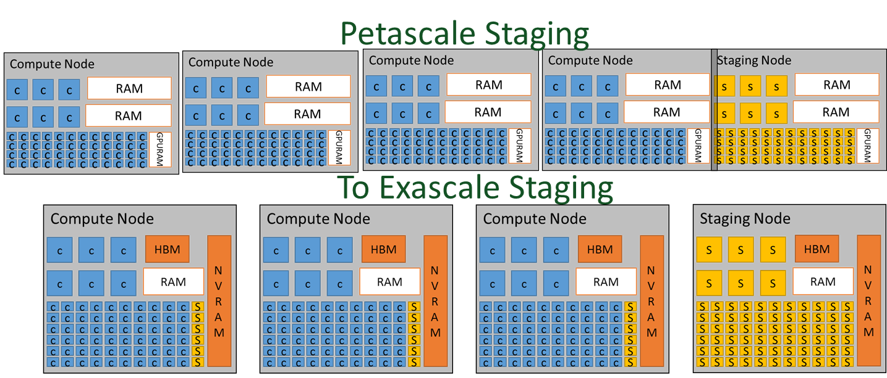
Staging
Use compute and deep-memory hierarchies to optimize overall workflow for power vs. performance tradeoffs
Abstract complex/deep memory hierarchy access
Placement of analysis and visualization tasks in a complex system
Impact of network data movement compared to memory movement
Abstraction allows staging
On-same core
On different cores
On different nodes
On different machines
Through the storage system

Slide 13
Workflow software integration: Swift/Decaf
Swift can dynamically launch MPI tasks at scale
Decaf can automatically redistribute bulk data from one task to the next
Desire to construct adaptive Swift workflows that use bulk data transfer techniques from Decaf
Example: simple Decaf pattern:
Boxes: MPI processes (ranks) Colors: MPI communicators (functional units)
Producers
Distributors
Analysis

Slide 14
Early result: Swift controlled Decaf transfers
Enable Swift to dynamically lay out tasks
Control large simulation/redistribute/analysis ensembles
Decaf analysis pipelines
Model exploration algorithm
Swift workflow control and load balancing

Slide 15
Several HPC floating point compression algorithms have emerged
Current interest is with lossy algorithms, some use preprocessing
Lossless usually achieves up to ~3x reduction
Compress each variable separately:
Several variables simultaneously:
ISABELA
SZ
ZFP
Linear auditing
SVD
Adaptive gradient methods
PCA
Tensor decomposition
…

Slide 16
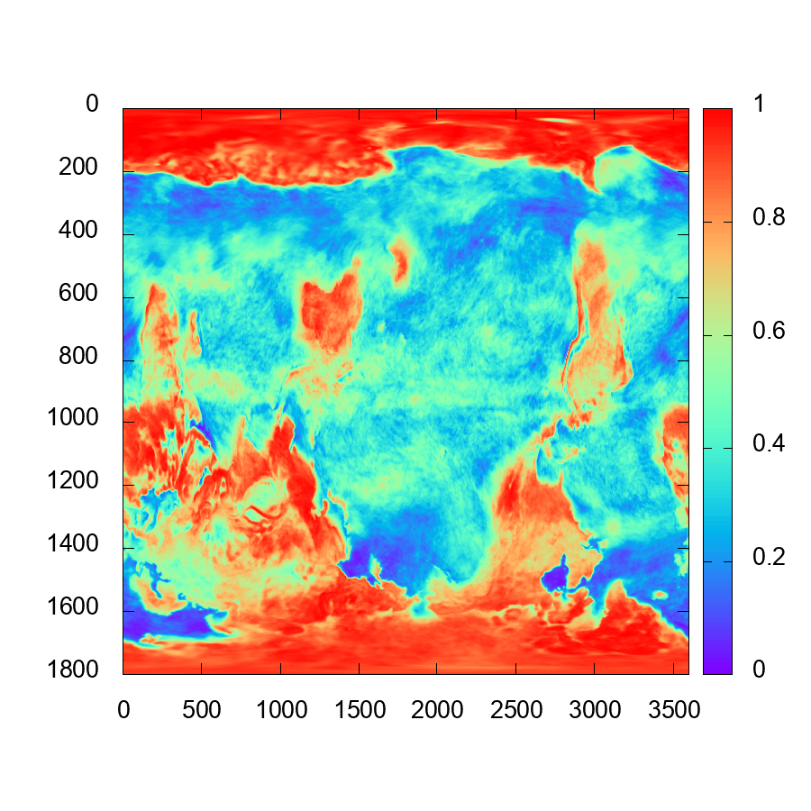
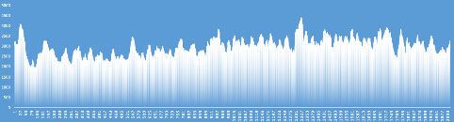
Lossy compression with SZ
No existing compressor can reduce hard-to-compress datasets by more than a factor of 2.
Objective 1: Reduce hard to compress datasets by one order of magnitude
Objective 2: Add user required error controls (error bound, shape of error distribution, spectral behavior of error function, etc. etc.)
NCAR atmosphere simulation output
(1.5 TB)
WRF hurricane simulation
output
Random noise
What we need to compress
(bit map of 128 floating point numbers):
Advanced Photon Source mouse brain data

Slide 17
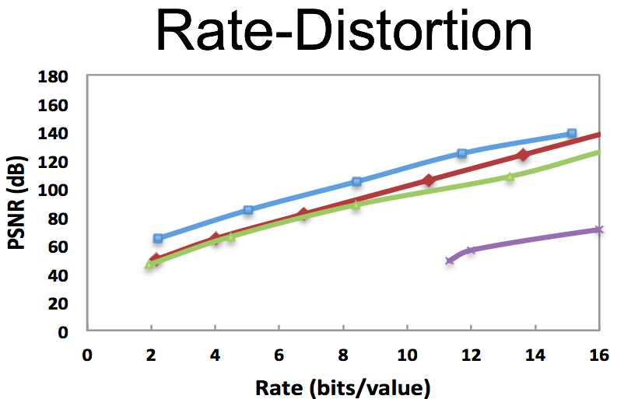
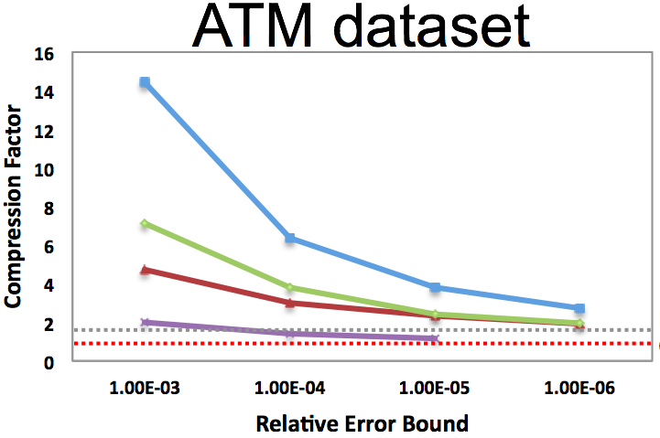
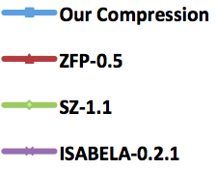
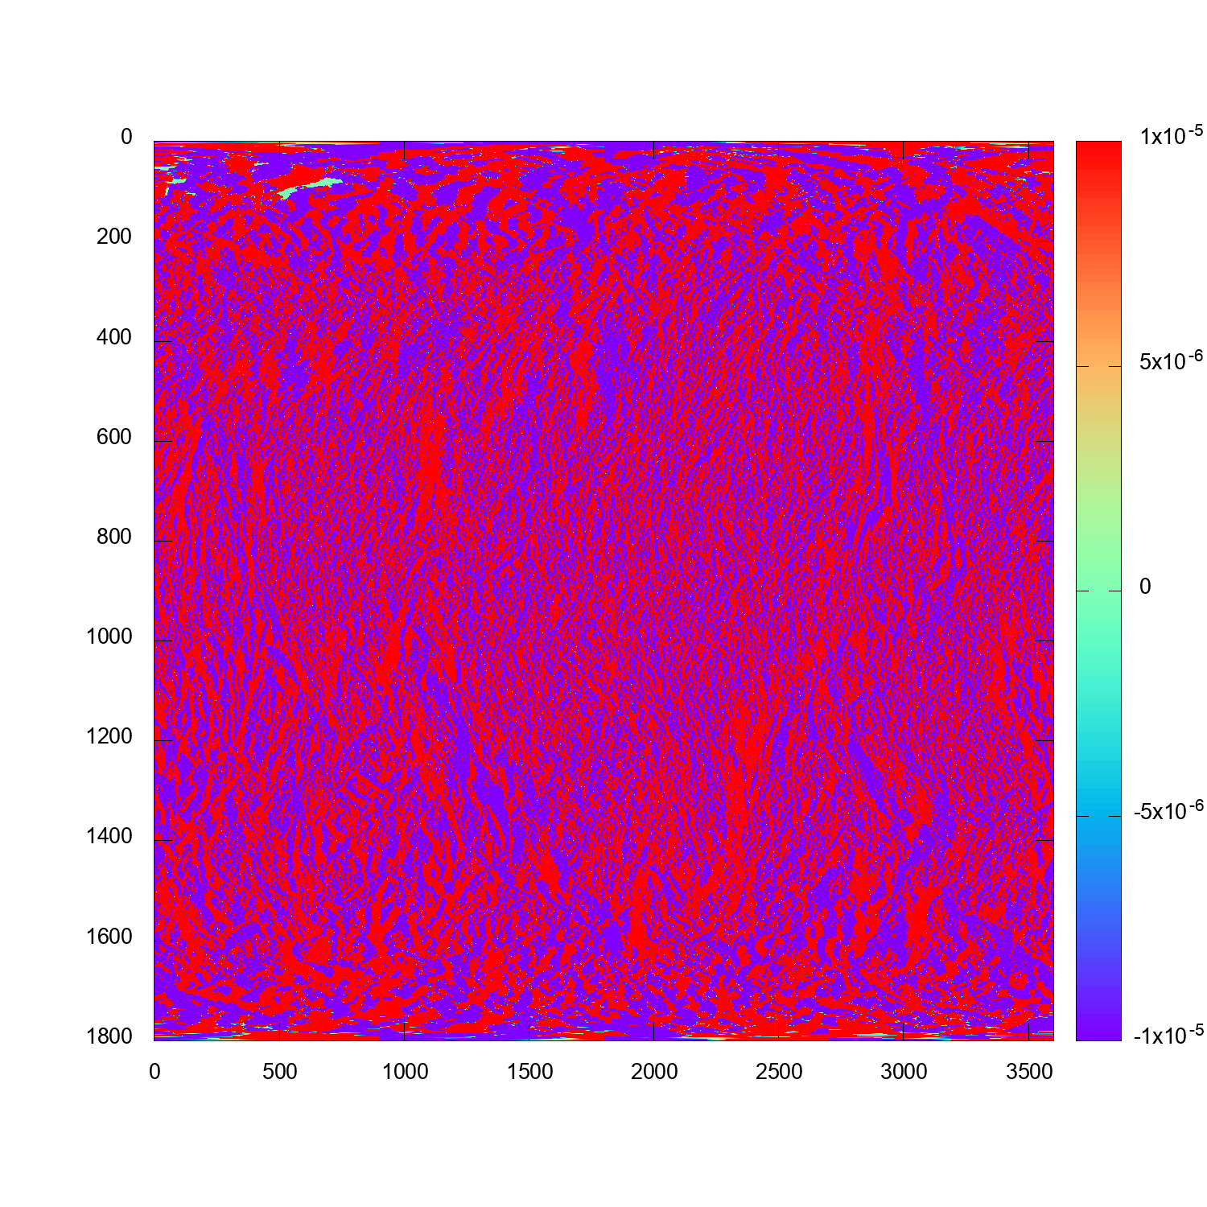
SZ lossy compres- sion
Error distribution
Autocorrelation of errors
Develop a framework for compression error characterization
Spectral behavior
Laplacian (derivatives)
Respect of error bounds
Error propagation

Slide 18
CODAR: Machine learning opportunities
NWChemEx
Rare trajectories event identification in molecular dynamics
NWChem use methods that bias the calculations to make rare events more likely
Can we identify trajectories where something interesting happens and give more compute resources to those paths and downgrade others?
Climate
Causation of interactions (e.g., aerosol- cloud interaction)
Cancer
Potential contributions of applying and/or develop DL methods
Notes:
NWChem
MD
Capabilities for classical and ab initio MD simulations in NWChem need to be extensible to address systems of millions of atoms as well as small molecular assemblies, use a hierarchy of sampling methods for the evaluation of properties with controlled statistical and systematic errors, and include realistic models for the molecular environment.

Slide 19
Provenance- data reduction for performance data
Collect performance data from all available sources to understand behavior of application-analysis-reduction pipelines
What is the “best” data to save to support co-design and application science goals?
A data reduction problem. Machine learning?
Develop codesign performance profiles and reports

Slide 20
CODAR
Center Objectives (Co-Designed Motifs)
Applications and S/W & H/W Technologies
Motif(s): Online data analysis and reduction
Address growing disparity between simulation speeds and I/O rates rendering it infeasible for HPC and data analytic applications to perform offline analysis
Target common data analysis and reduction methods (e.g., feature and outlier detection, compression) and methods specific to particular data types and domains (e.g., particles, FEM)
Reduce application development risk by providing performance tradeoffs for offline vs inline analyses of simulation results, produce and integrate into applications high-performance products embodying data analysis and reduction
Key metrics: use of CODAR tools and technologies by applications; improvements in data analysis efficiency and information-to-data ratios in application outputs
Applications Targeted
Climate (ACME), Materials Science, Magnetic Fusion Energy, Chemistry, Cosmology, QCD, Experimental Light Sources, Cancer
Software Technologies Cited
MPI, OpenMP, Pthreads
ADIOS, Swift, ZFP, SZ, Globus, DIY/Decaf, VTK-m, PETSc/TAO, Trilinos
Hardware Technologies Addressed
Communication network, on-node memory hierarchy, system solid state memory (placement and usage for burst buffers), I/O design for data movement on and off exascale system
Risks and Challenges
Development Plan
Ineffective interaction with application project teams
Insufficient resources to perform work
Scope creep
Unknown performance of tools at exascale
Poor performance, scalability, or energy efficiency
Fail to meet application team delivery expectations
Poor interaction with ECP and other software teams
Exascale apps not ready
Test systems not available
Y1: Application engagements under way; experiments on LCF systems; CODAR Services Beta with first integrated data analysis and reduction services; Domain-specific services
Y2: Experiments on ECP testbed; First CODAR Services monitoring capability; Expanded set of data analysis and reduction services; CODAR Runtime Beta with integrated control layer; Demonstration of 10:1 data reduction for two ECP apps
Y3: CODAR Services and Runtime v1.0 with additional services included; CODAR used inside four ECP applications on LCF systems
Y4: CODAR v2.0, with adaptive data reduction; At-scale demonstrations on LCF systems; CODAR used in four ECP applications with 100:1 data reduction
PI: Ian Foster (ANL); Institutions: ANL, BNL, ORNL, Brown, Rutgers, Stony Brook

